Slide 1

DATA ARCHITECT
CASE STUDY

Slide 2



We are on the edge of a pivotal moment for humanity, where our decisions will define not just our future but also the future of humankind.
At Kiwibot we fundamentally believe on a sustainable and democratic delivery service, that is our north.
And that is why we are creating
The Internet of Atoms

Slide 3


Instructions: You have 5 business days from the moment you received this assignment to complete the following tasks.

Slide 4


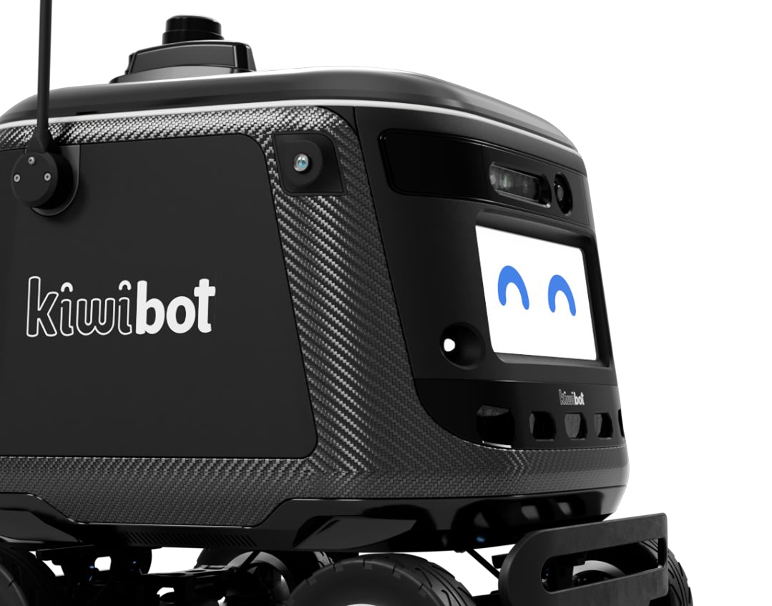
Assignment 1: — Data Architecture
Based on what you know about Kiwibot, design what you think is the Entity Relationship Diagram of Kiwi’s main operation database.
Take into account variables such as deliveries, incidents on the road, maintenance to the bots, georeferenced logs, cities in which we’re operating, current employees, employees on recruitment and more you can imagine. Use the tools you like to show your point of view based on what you know about us and your data expertise.

Slide 5
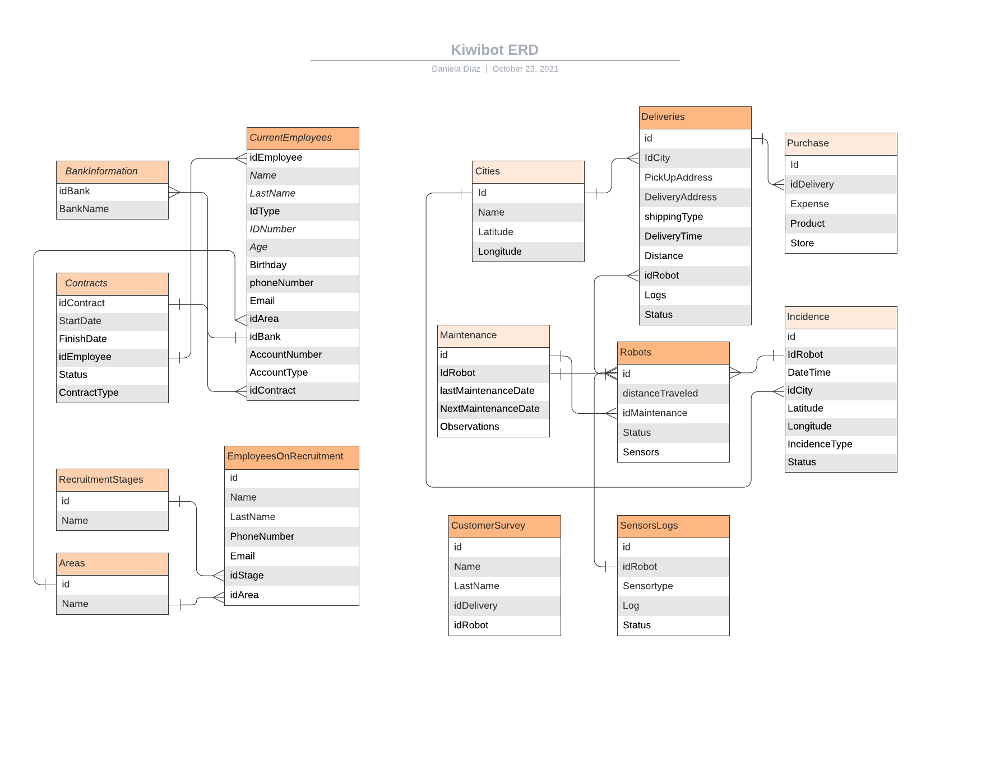
Assignment 1: — Data Architecture

Slide 6


Assignment 2: — Data Implementation
How would you deploy this architecture in Kiwibot? Please explain the methodology, activities and technology that you’d like to use in order to optimize the data consumption inside the organization.
Note: We use GCP as main platform but we’re open to know more about your experience and ideas that you think will make the data querying process more eﬀicient.

Slide 7


Assignment 2: — Data Implementation
1. Data integration: Understand how all the systems and areas of the company can be integrated to another
Batch Load: Data related to HR or Maintenance information can be uploaded in a load job because it doesn’t need to be continuously updated.
2. Load data into data warehouse: As the company is already using GCP, I propose BigQuery Service
Streaming: Data related to Deliveries or log sensors need to be updated close real time
Goal: Merge information coming from different data sources into one comprehensive database.

Slide 8



Assignment 2: — Data Implementation
3. Define business goals: Considering the available data, define the questions the company should ask, and data should answer in order to improve business decisions.
4. Visualization tool: Connect to data in Bigquery and create dashboard that answers the right business questions.

Slide 9

Assignment 3: — Business Understanding
What do you think are the business related questions that would help us build a better data awareness for our company’s business?
Think about the kind of questions that you believe we have to face everyday in order to apply and improve our business model.

Slide 10
Assignment 2: — Data Implementation
Business related questions
What is the rate of undelivered shipments?
Which is the main cause the robot doesn’t reach the destination or undelivered shipments?
Which is the main cause the robot is out of service?
How many shipments have been delivered by month?
What is the profit by month?

Slide 11

Assignment 4: — Business Evaluation
How would you visualize each of those business questions to materialize them into tangible actions? What tools would you use?
You can propose external resources from the academia, commercial tools or past experiences to persuade towards convincing decision makers to take data-driven actions based on your insights.

Slide 12
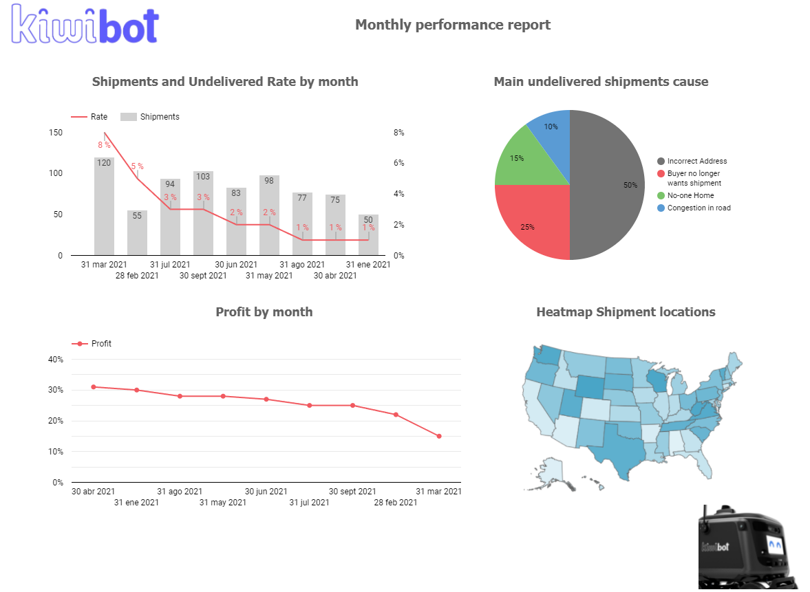
Assignment 2: — Data Implementation
Visualization As I mentioned before, I propose Data Studio as a visualization tool, considering that Google Cloud is the platform that is currently being used, which ease the connection between the tools. I would also recommend Power BI or Tableau, due to the large amount of data. There is brief example of a dashboard in Data Studio answering the business questions above.
https://datastudio.google.com/reporting/b2cea4b4-a8aa-4b97-8e0e-1a28d2a7a3ac

Slide 13

Note:
In order to complete this task you can use a deck, spreadsheets, documents, graphics, text, video, a landing page or any other resource of your liking, it’s up to you!
The deliverable must be in English and submitted to your Github.

Slide 14
GOOD LUCK!

